Slide 1
OPTICAL FIBER COMMUNICATION
Dr. Pramod Kumar Singh
Department of Physics
Assit. Prof. & Head
Shri Sadguru Saibaba Science & Comm. College,
Ashti, Dist.-Gadchiroli (MS)

Slide 2
Contents
Introduction
Block diagram
Principle
Classification
Advantages
Disadvantages
Applications
Conclusions

Slide 3
Introduction
Fiber-optic communication is a method of transmitting information from one place to another by sending pulses of light through an optical fiber .
An optical fiber is a flexible, transparent fiber made by glass (silica) or plastic to a diameter slightly thicker than that of a human hair.

Slide 4
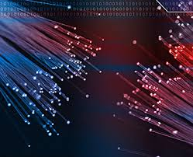
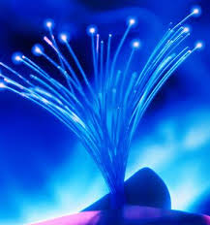
Seeing light at the end of the tunnel

Slide 5
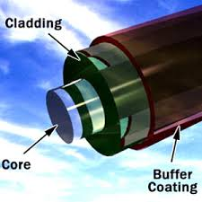

BLOCK DIAGRAM

Slide 6
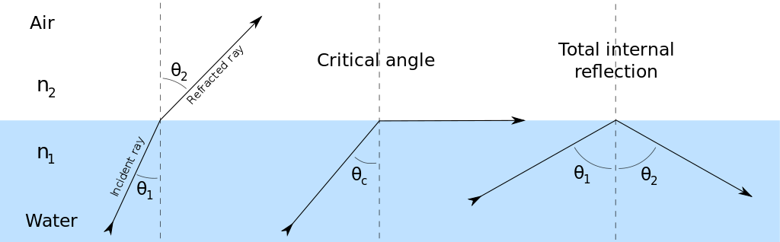
PRINCIPLE OF OPTICAL FIBER
TOTAL INTERNAL REFLECTION
Total internal reflection is a phenomenon which occurs when a propagating wave strikes a medium boundary at an angle larger than a particular critical angle with respect to the normal to the surface.

Slide 7
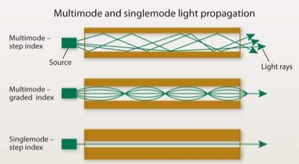
TYPES OF OPTICAL FIBER
There are two type
The Number of Modes
(i) Single Mode Fiber
(ii) Multi Mode Fiber
The Refractive Index
(i) Step Index
(ii) Graded Index

Slide 8
ADVANTAGES
The life of fiber is longer than copper wire.
It is unaffected with electromagnetic interference.
Loss of optical fiber is lower than the coaxial & twisted pair.
There is no necessity of additional equipment for protecting against grounding and voltage problems.
Handling and installation cost of optical fiber is very nominal.

Slide 9
DISADVANTAGES
Highly Skilled staff would be required for maintenance.
Only point to point working is possible on optical fiber.
Accept unipolar codes only.
Jointing of fiber and splicing is also time consuming
Precise and costly instruments would be required

Slide 10
APPLICATIONS
Optical fiber have wider range of application in almost all field.
(i) In telecommunication.
(ii) In space.
(iii) Medical .
(iv) Industrial and computer.
(v) Mining.
(vi) In military applications etc.

Slide 11
Conclusions
I concluded that optical fiber communications are basic knowledge. The presentation also not covers all the aspects of optical fiber.

Slide 12
THANK YOU

